Slide 1
THIS is fine: Firefighting for the DBA
Matt Gordon

Slide 2
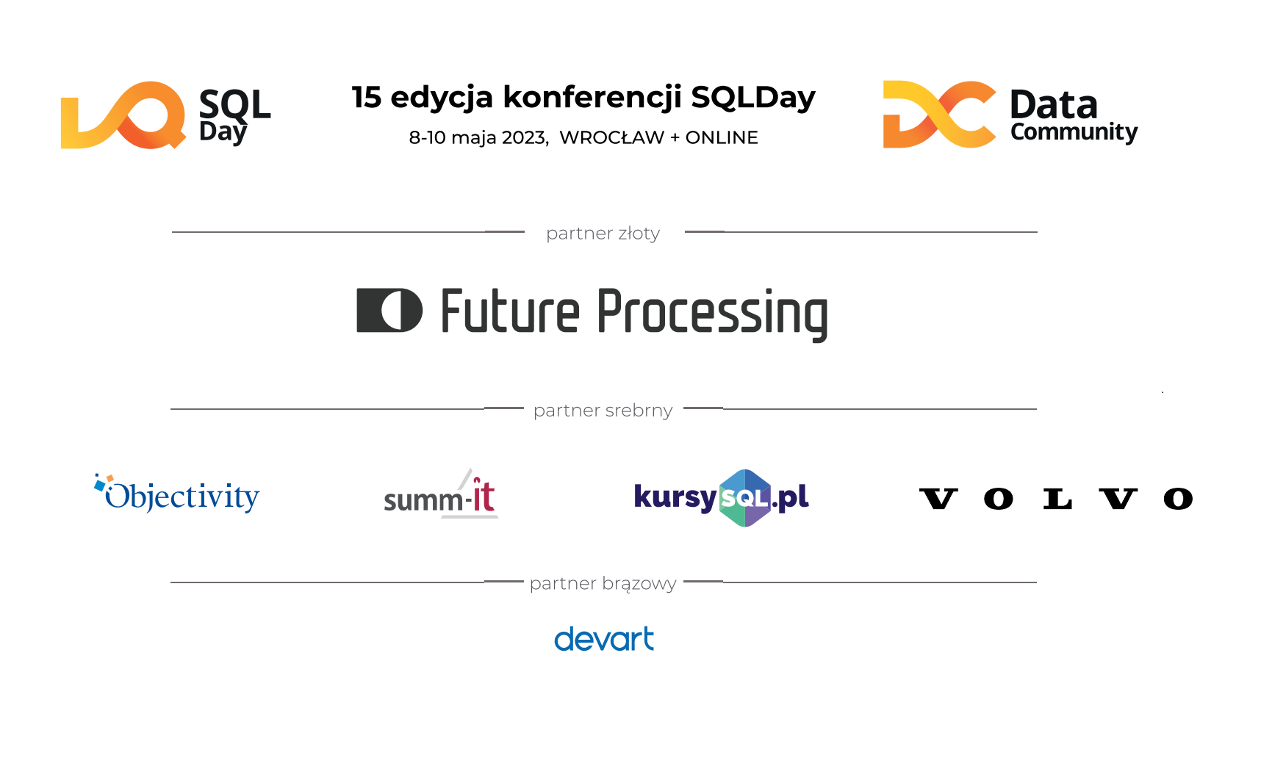

Slide 3


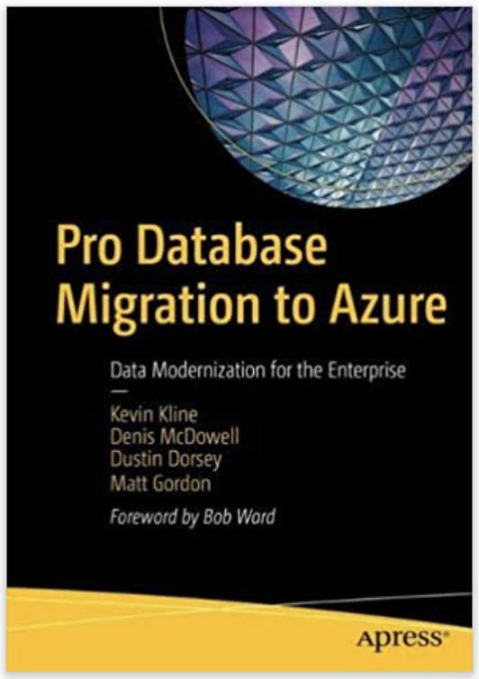

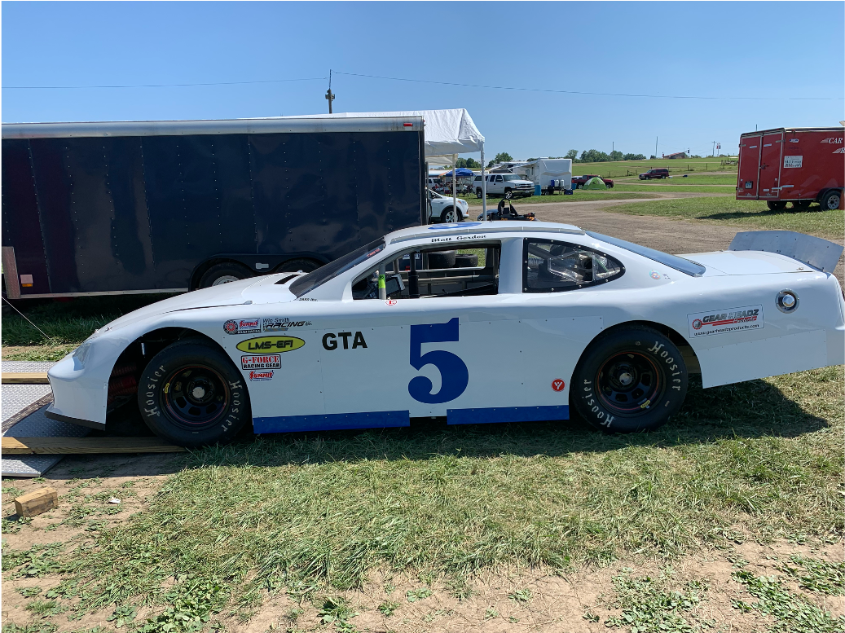
Matt Gordon
Senior Architect
matt@sqlatspeed.com
: @sqlatspeed
www.sqlatspeed.com

Slide 4

About me
20+ years of SQL Server experience
Microsoft Data Platform MVP
Redgate ambassador
Managed 24x7 datacenters
Leader of Lexington, KY (USA) Data Technology Group

Slide 5
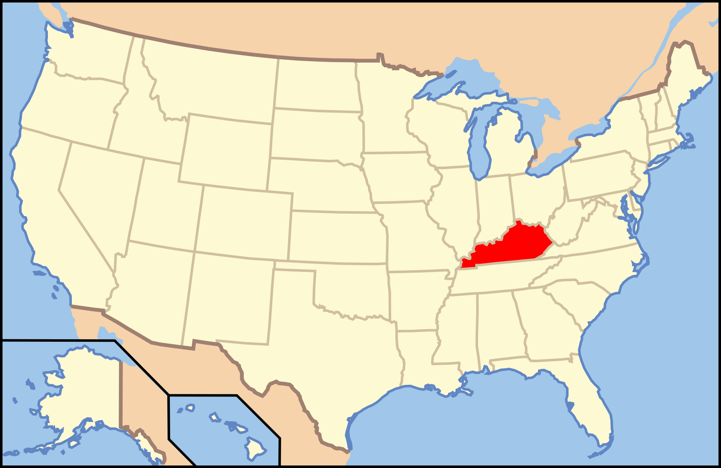
About me – WHERE I LIVE

Slide 6



Notes:
Remind how the original webcomic (”On Fire” by KC Green) does not end well for the dog – we don’t want to be the dog

Slide 7
WHAT DOES “FINE” MEAN?
Do you baseline your databases?
Is your baseline data-driven or gut feel?
How can we baseline our databases?

Slide 8
How do we baseline our databases?
Third-party tools FOR SQL SERVER
Solarwinds sql sentry (aka sentryone)
Redgate sql monitor
Idera diagnostic manager

Slide 9
How do we baseline our databases?
Third-party tools FOR POSTGRESQL
DATADOG (POSTGRESQL INTEGRATION NEEDED)
SOLARWINDS SERVER & APPLICATION MONITOR (MYSQL TOO!)
APPOPTICS APM

Slide 10
How do we baseline our databases?
Third-party tools FOR ORACLE
Solarwinds DPA (DATABASE PERFORMANCE ANALYZER)
Site 24x7 ORACLE DATABASE MONITORING
dbWatch (MULTIPLE DBMS)

Slide 11
How do we baseline our databases?
WHAT ABOUT PRTG?
What about new relic?
Notes:
These can provide some sense of a baseline but are really more active monitoring tools

Slide 12
How do we baseline our databases?
Community tools
Glenn berry’s diagnostic queries
SQL Server TIGER TEAM RESOURCES
Brent ozar’s sp_blitz* stored procedures
KEVIN kline’s baselining and monitoring video
Notes:
All links on resource slide

Slide 13
How do we baseline our databases?
Roll your own
perfmon
Dmv queries (SQL SERVER) / ACTIVE SESSION HISTORY (ORACLE)
Hourly/daily/etc reports on execution times

Slide 14
WHAT Isn’t Fine?
How do we know what’s wrong?
Who/What was the source of the report?
Is it solely a database issue?
Is it a database issue at all?

Slide 15
How TO prove what is (and isn’t) fine?
Monitoring tools
DMV QUERIES (SQL) / QUERIES AGAINST DBA_HIST_ACTIVE_SESS_HISTORY (ORACLE)
Performance monitoring with dmvs (Microsoft article)
TOP 10 USEFUL ASH QUERIES (community oracle blog)
Wait stats (SQLSKILLS RESOURCES)
Sp_whoisactive
No non-sql server equivalent that I have found

Slide 16
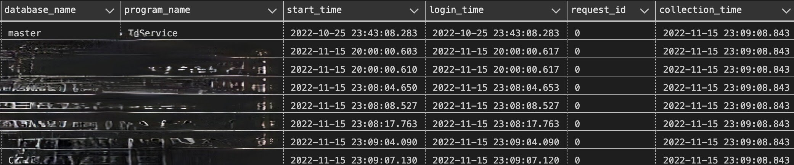

Slide 17
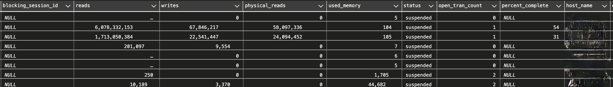

Slide 18
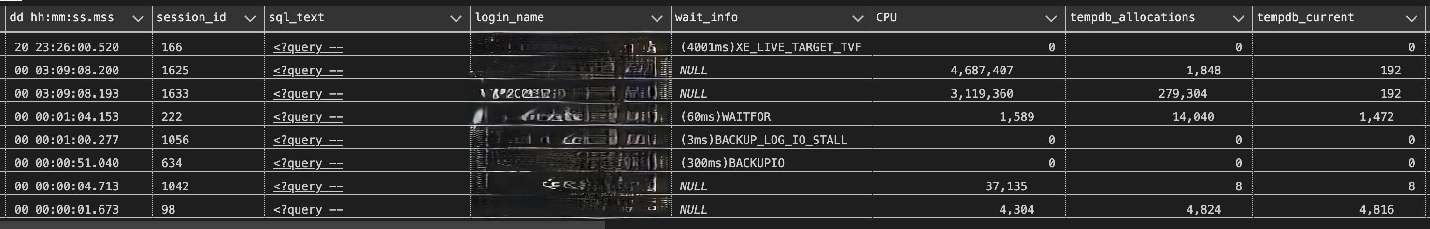

Slide 19
How TO prove what is (and isn’t) fine?
Query store! (AWR in ORACLE)
We can do all this in azure, but azure can do some things as well
Notes:
Query store now on by default in SQL Server 2022 and all new Azure SQL DBs as well

Slide 20
What DB Monitoring can azure provide?
Query store! (AWR IN ORACLE)
Query performance insights
Sql insights
In preview as of now
MORE INFO HERE
Notes:
Data exposed episode covering SQL Insights (meant to be one stop shop for all Azure SQL flavors)
SQL Insights does not support gathering metrics from Basic and other low service tiers and has limited functionality in Serverless but DOES work on MI
Query Performance Insights is Azure SQL only and requires Query Store to be on in the monitored database

Slide 21
How do we fix what isn’t fine?
State the problem
Identify teams/people involved
Follow process
Profit!
Notes:
CI/CD can be a massive help here because it can often get us out of the finger pointing and research time lost identifying who broke what

Slide 22
Are we fine?
Are you feeling your best?
Are you performing at your best?
Baseline yourself
Notes:
”are you feeling your best? & are you performing at your best?” are two different, and sometimes unrelated questions
I have often felt that I was performing at my best during the high of problem solving but it is not true

Slide 23
How do I baseline myself?
Gut feel
Journal
Data
Daylio
@SQLGENE’s SQLBITS SESSION
Notes:
Put link to sqlgene’s blog and link to future bits video here as well

Slide 24
You are not highly available
Proper procedures
Good partners
Advocate for yourself and the team
“superhero complex” isn’t healthy
Find support where you can
https://dataplatformwit.com/data-platform-wit-mental-health-and-wellness-day-2022/

Slide 25
We’re all going to be fine
You’re here!
Make connections
Reach out – many people are ”here” to help
#SQLHELP on twitter/MASTODON
SQL COMMUNITY SLACK AT SQLSLACK.com
SQL COMMUNITY DISCORD (https://discord.gg/Gp3Gdnd7)
Notes:
The “here” can be virtual as well

Slide 26
The slide where I shill for my books
Cognitive services book
Database migration book

Slide 27
Additional resources
Glenn berry’s diagnostic queries
SQL Server TIGER TEAM RESOURCES
Brent ozar’s sp_blitz* stored procedures
KEVIN kline’s baselining and monitoring video

Slide 29
THANKS FOR ATTENDING!
Matt Gordon
Senior Architect
matt@sqlatspeed.com
: @sqlatspeed
www.sqlatspeed.com
https://github.com/sqlatspeed/2023_presentations

